Slide 1
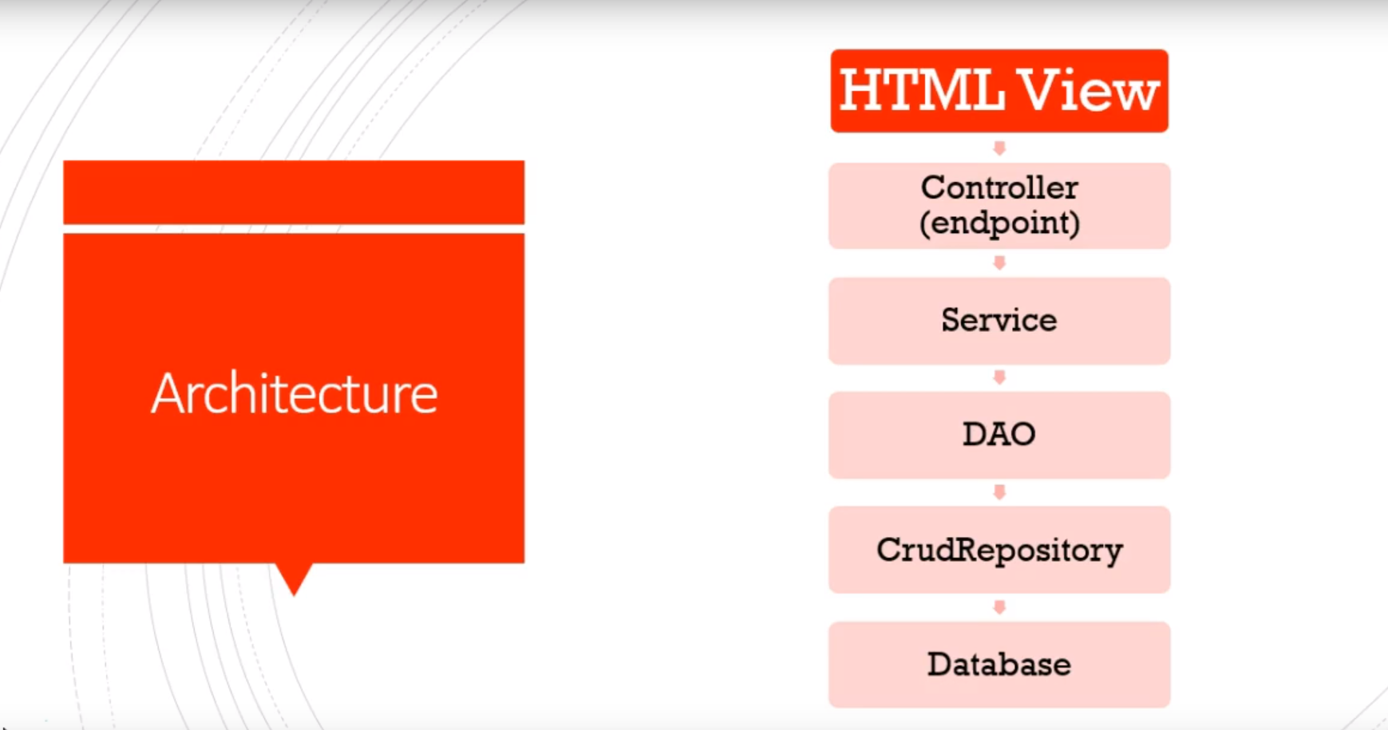
Spring Boot Cache

Slide 2
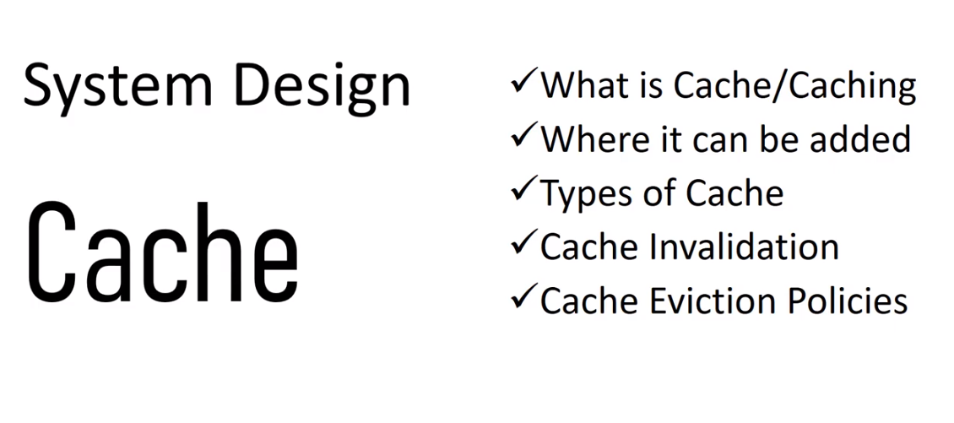
Spring Boot Cache

Slide 3
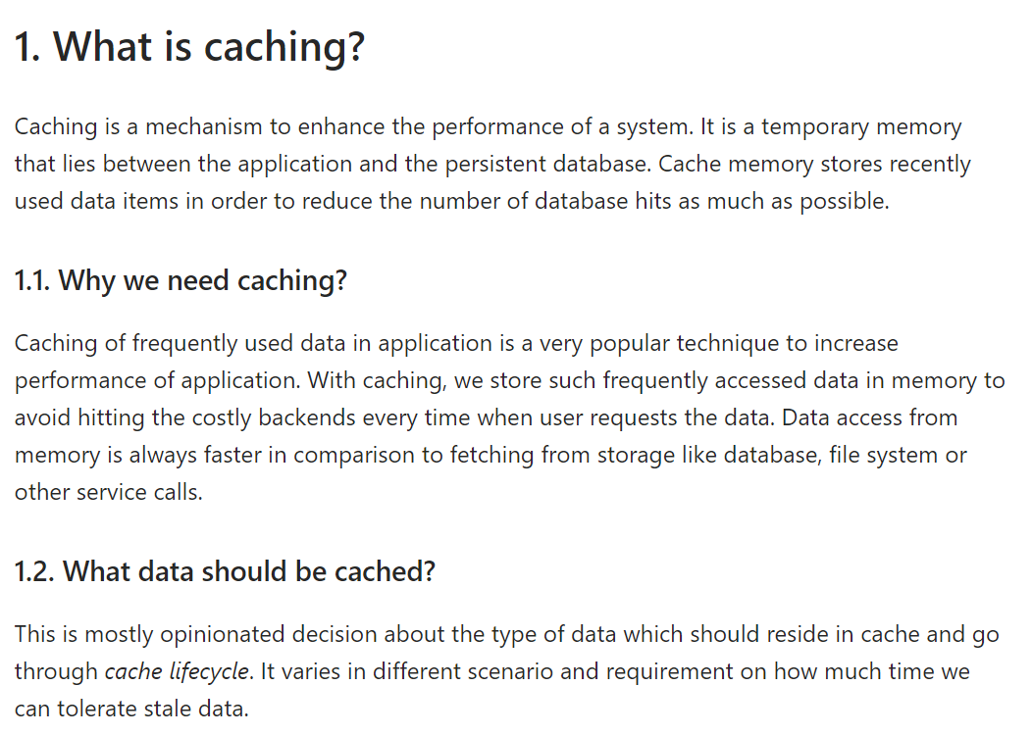
Spring Boot Cache

Slide 4
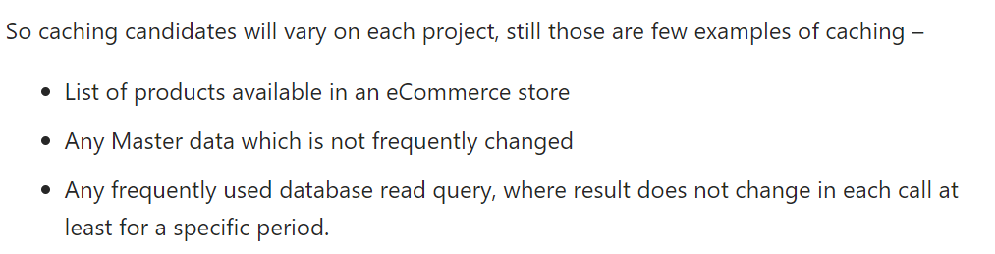
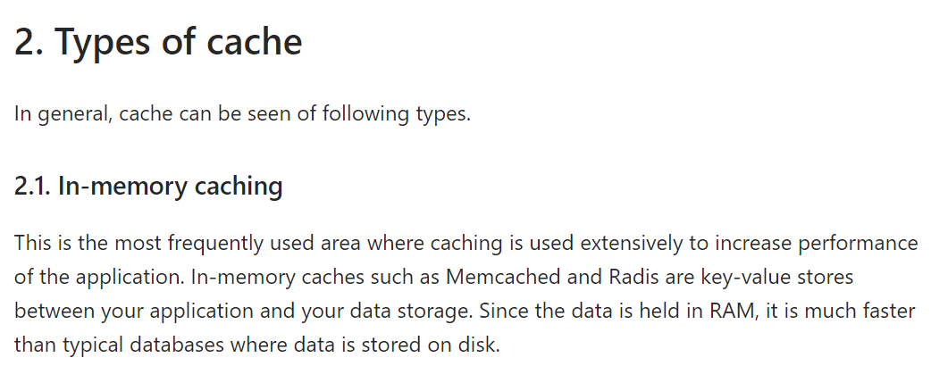
Spring Boot Cache

Slide 5
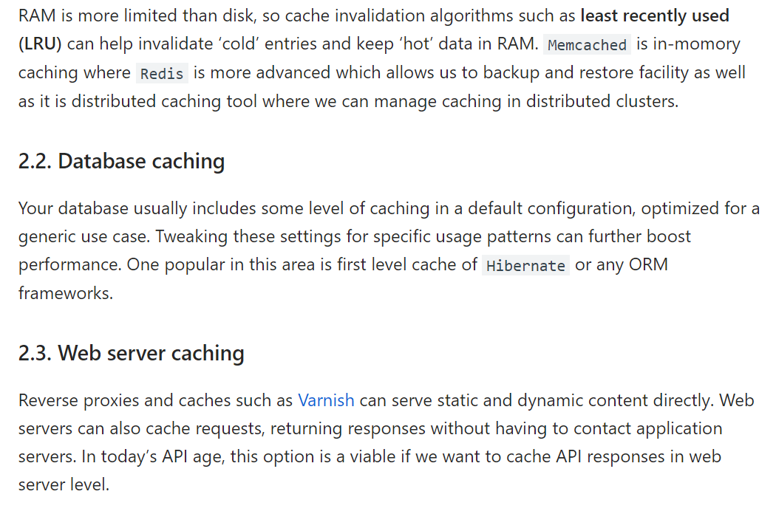
Spring Boot Cache

Slide 6
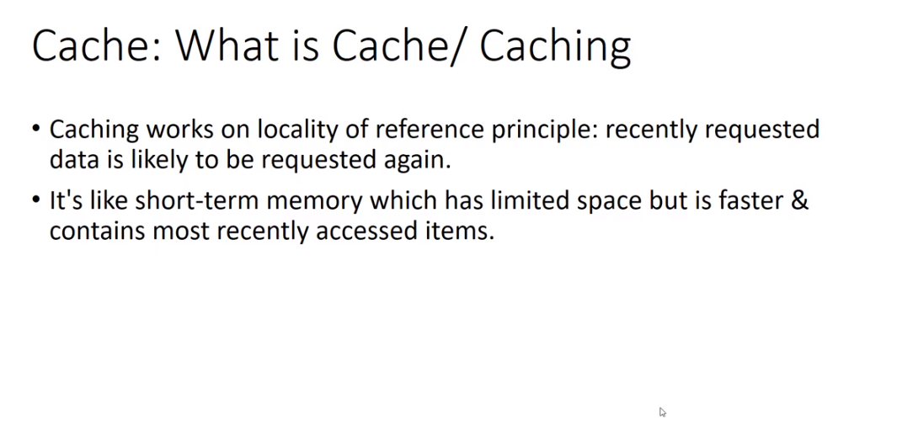
Spring Boot Cache

Slide 7
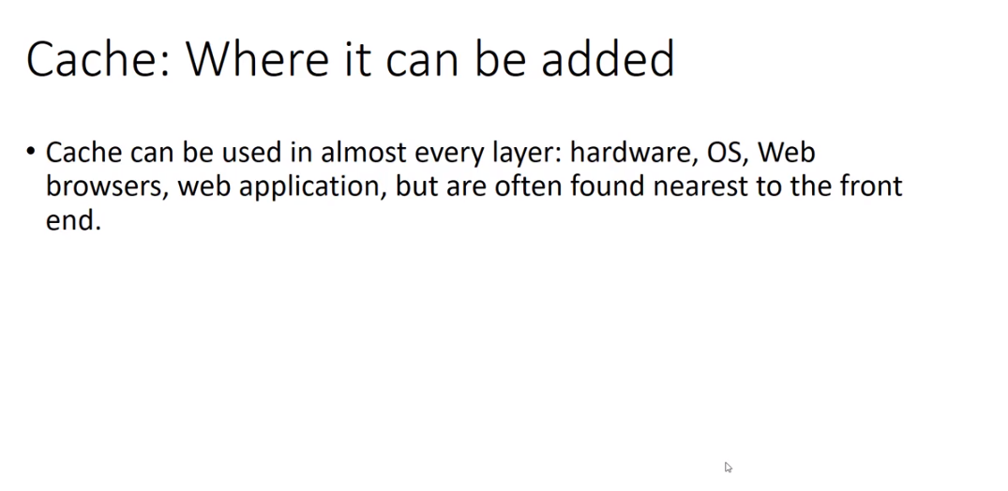
Spring Boot Cache

Slide 8
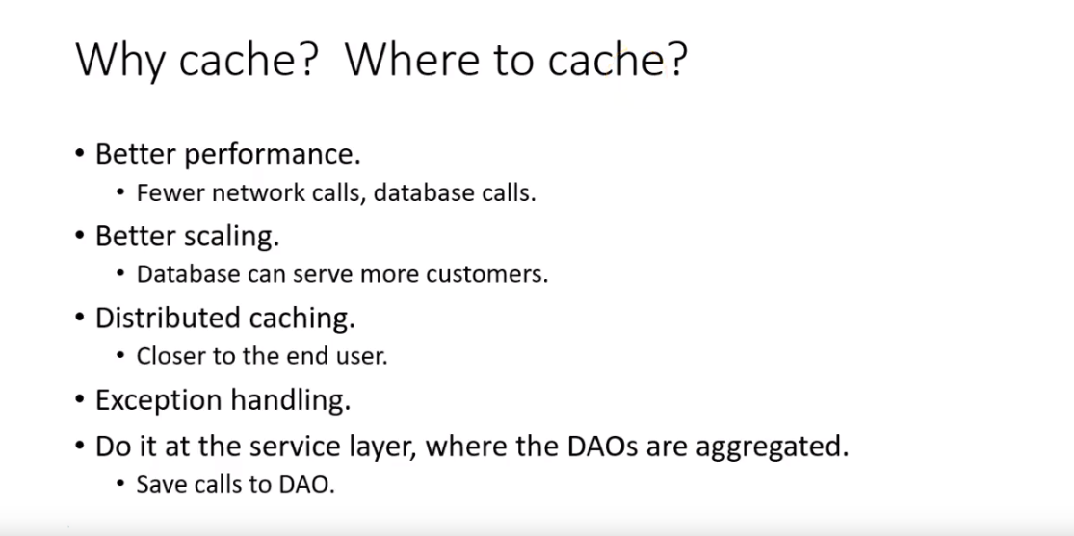
Spring Boot Cache

Slide 9
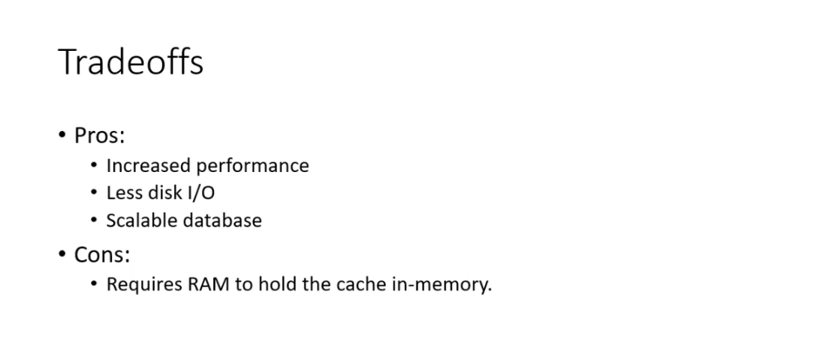
Spring Boot Cache

Slide 10
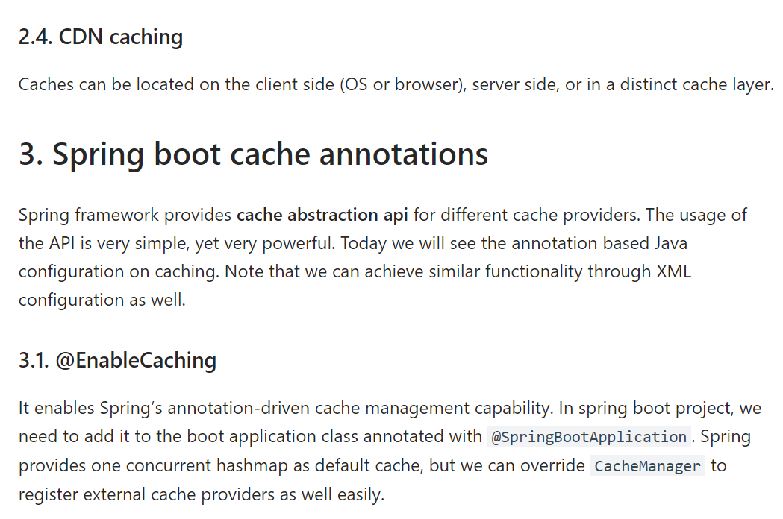
Spring Boot Cache

Slide 11
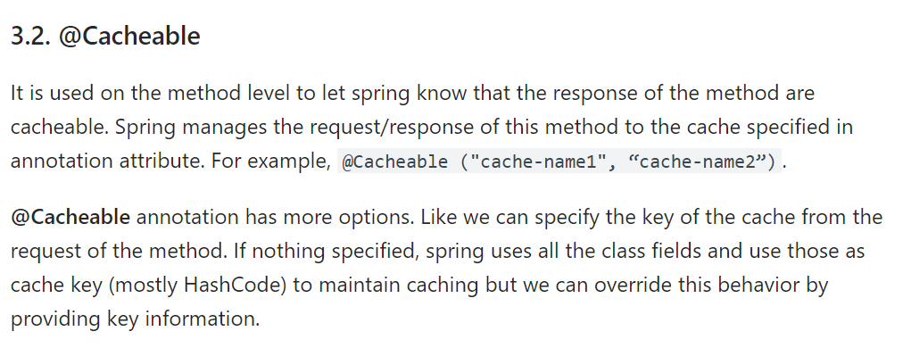
Spring Boot Cache

Slide 12
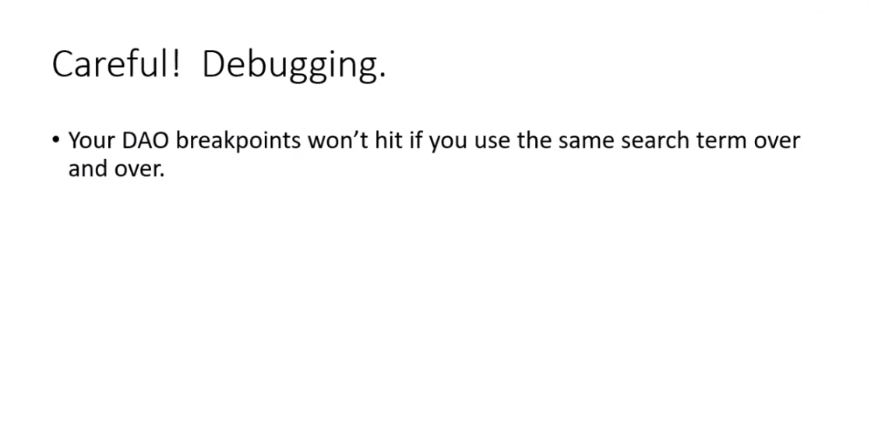
Spring Boot Cache

Slide 13
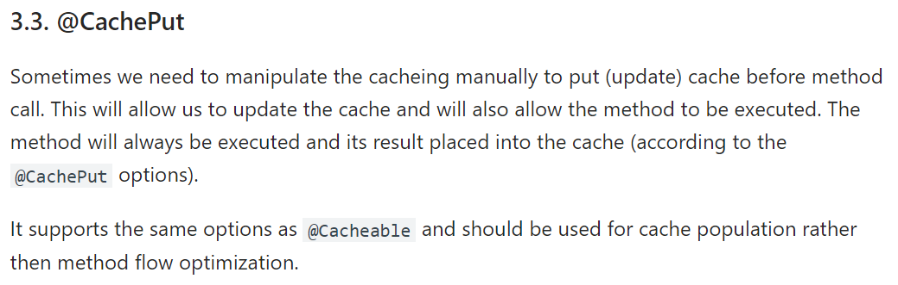
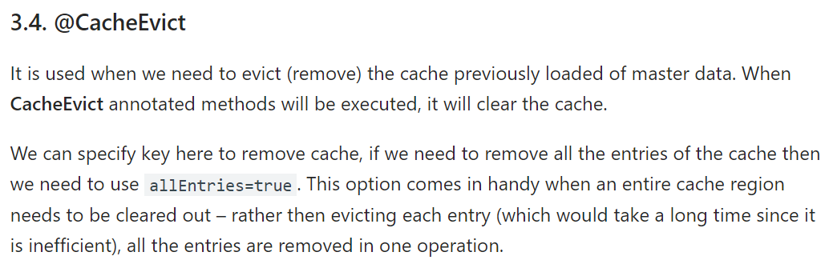
Spring Boot Cache

Slide 14
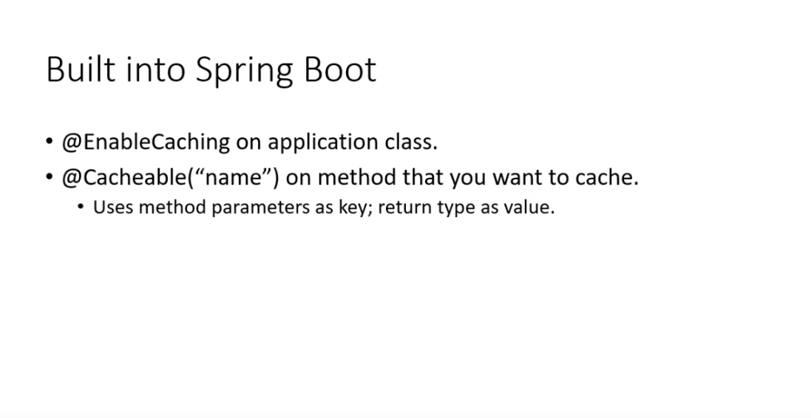
Spring Boot Cache

Slide 15
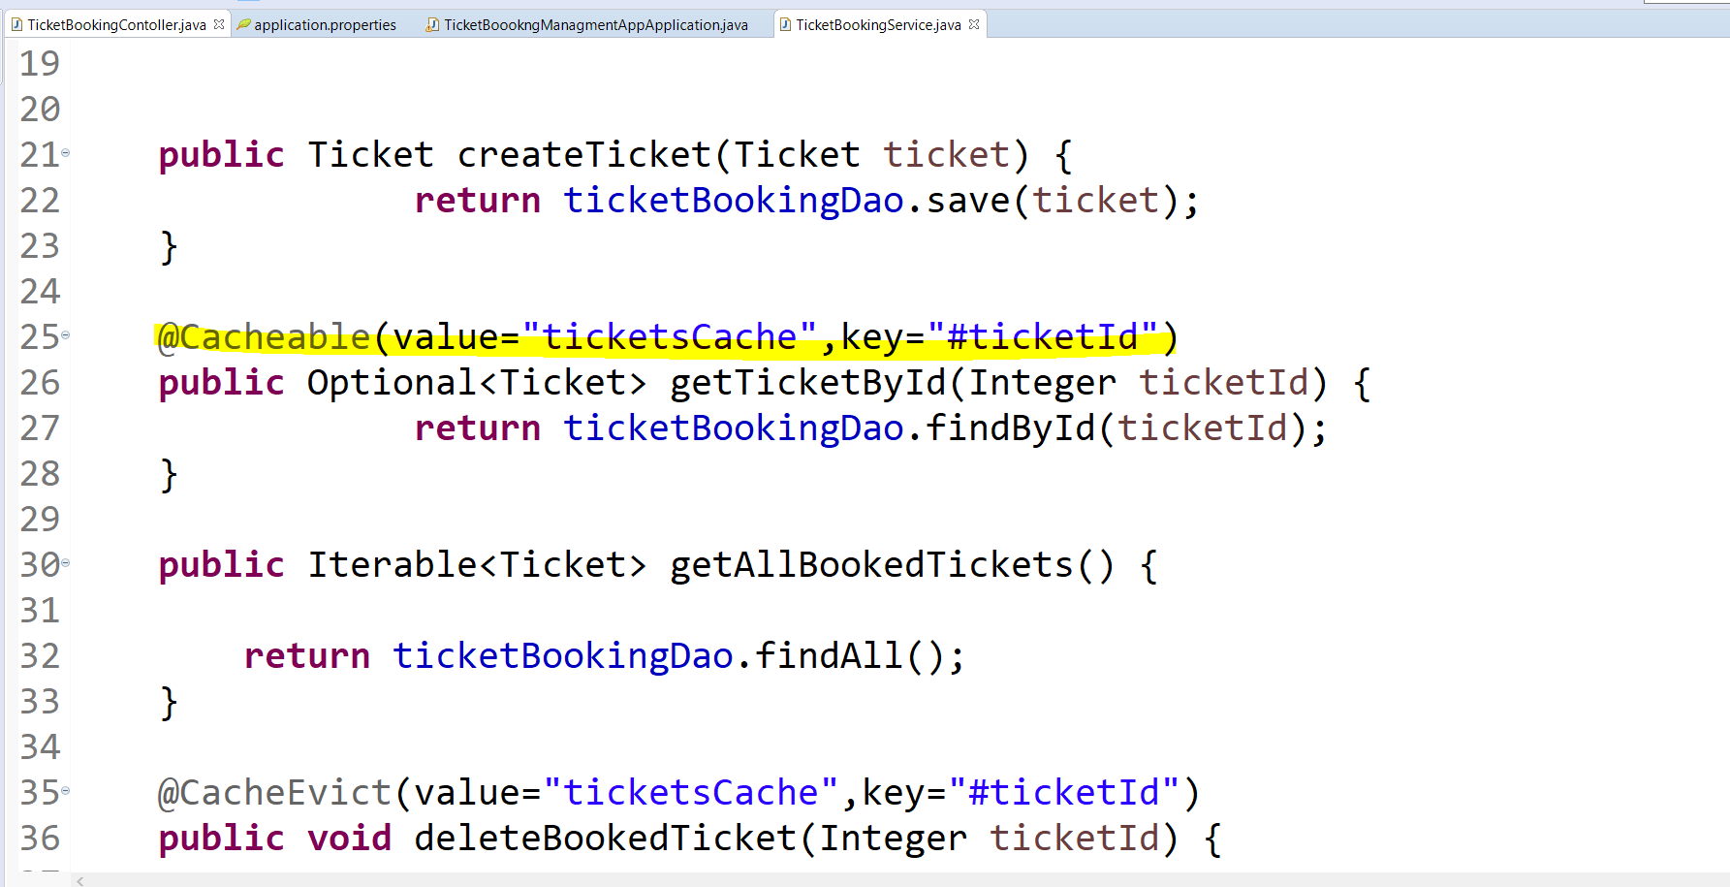
Spring Boot Cache

Slide 16
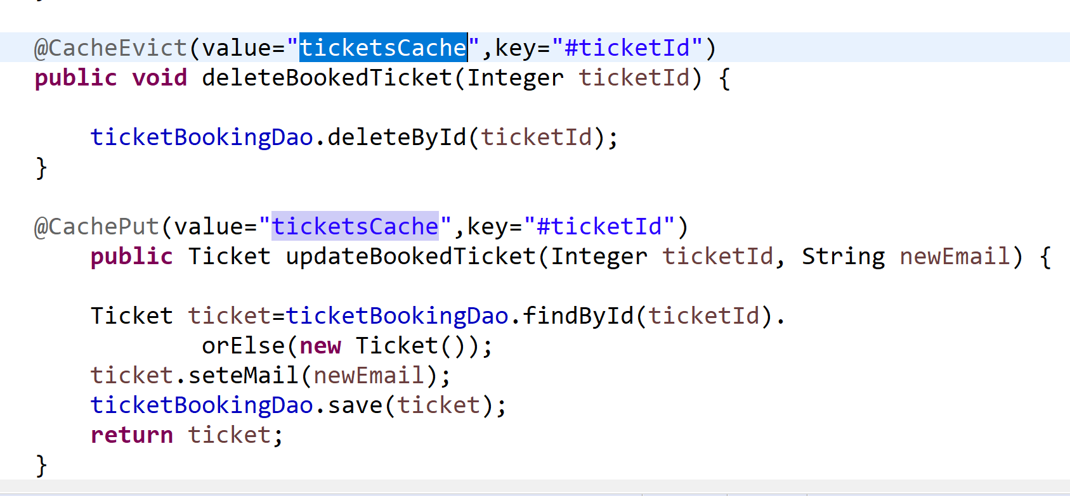
Spring Boot Cache

Slide 17
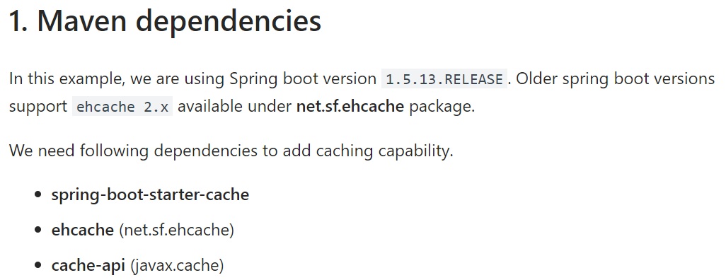
Spring Boot Cache - EHCache

Slide 18
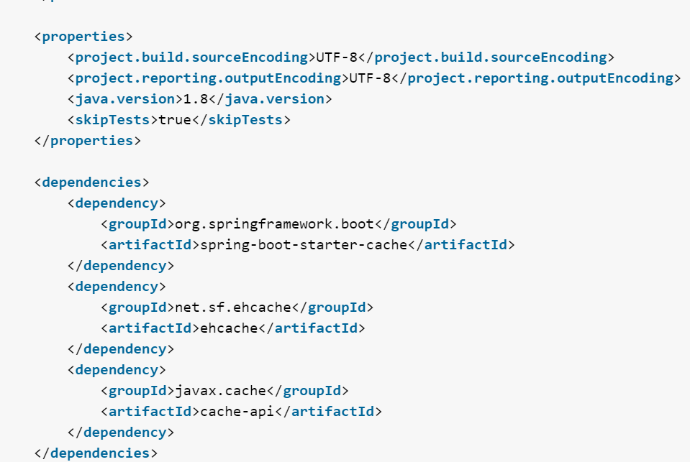
Spring Boot Cache - EHCache

Slide 19
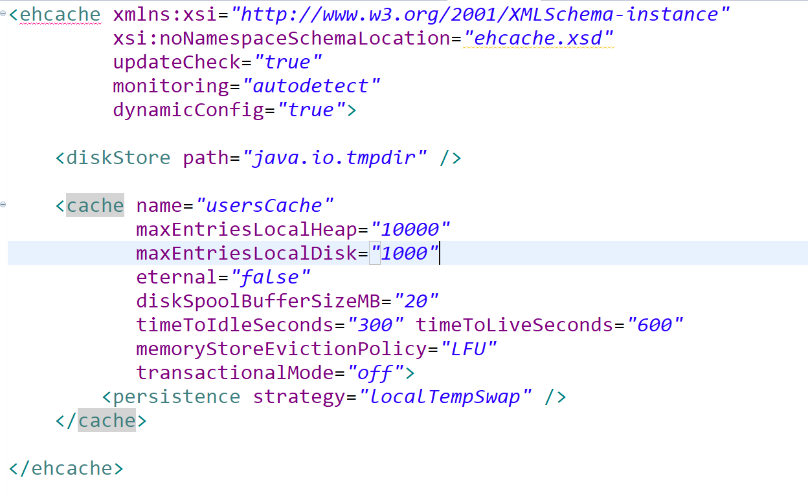
Spring Boot Cache - EHCache

Slide 20
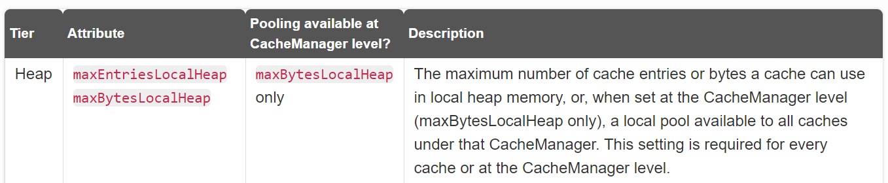
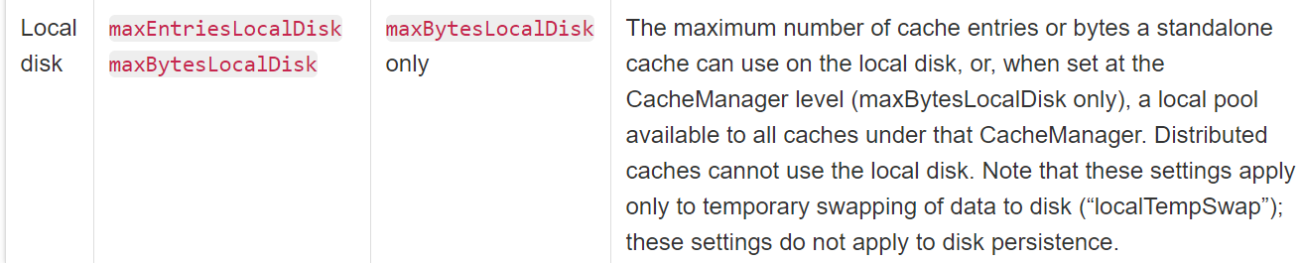
Spring Boot Cache - EHCache

Slide 21
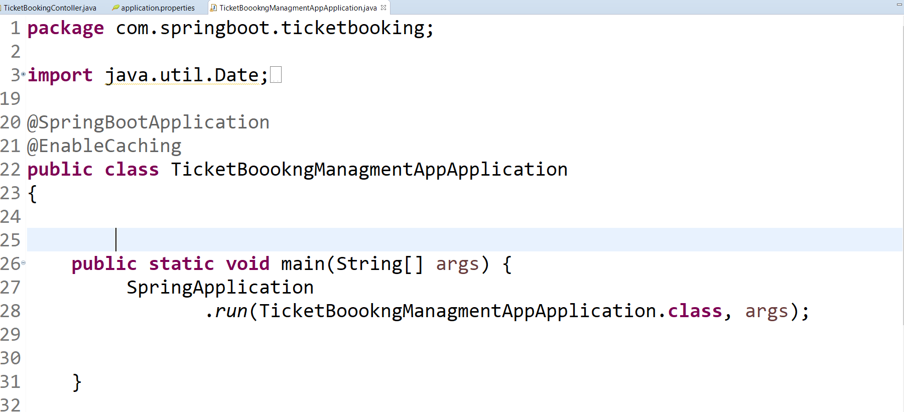
Spring Boot Cache

Slide 22
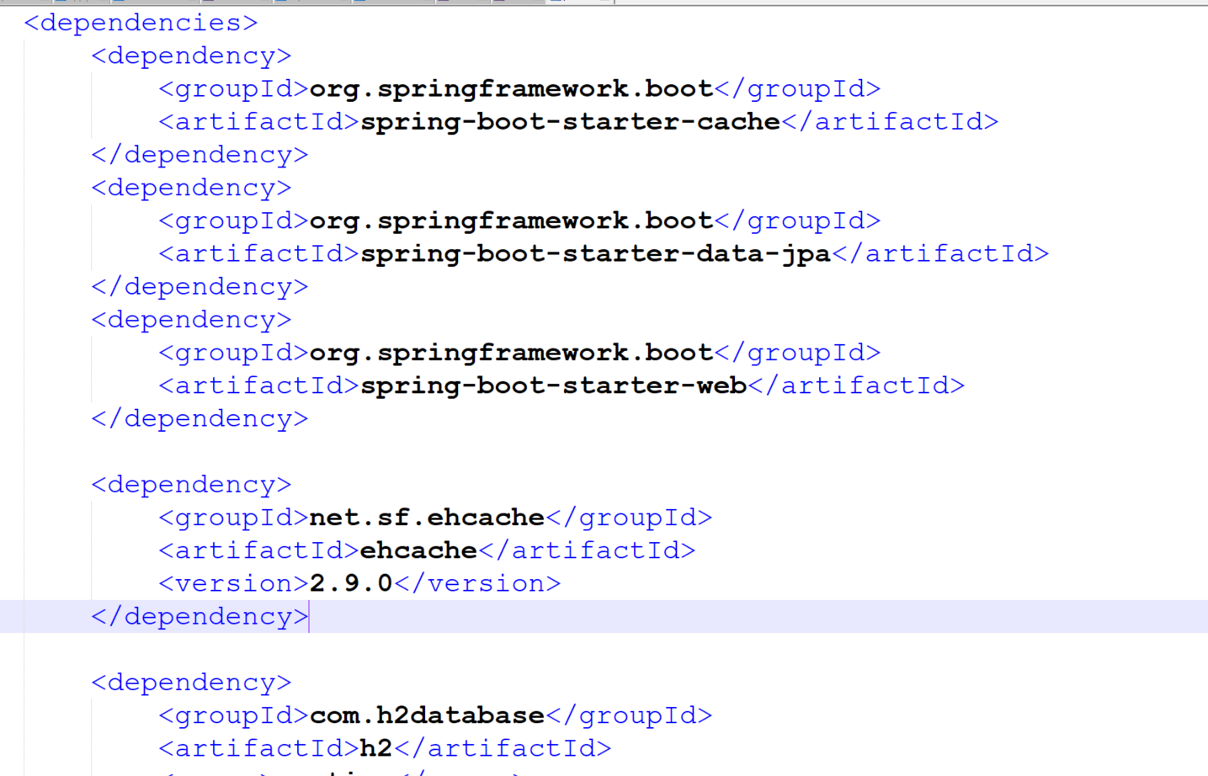
Spring Boot Cache - EHCache

Slide 23
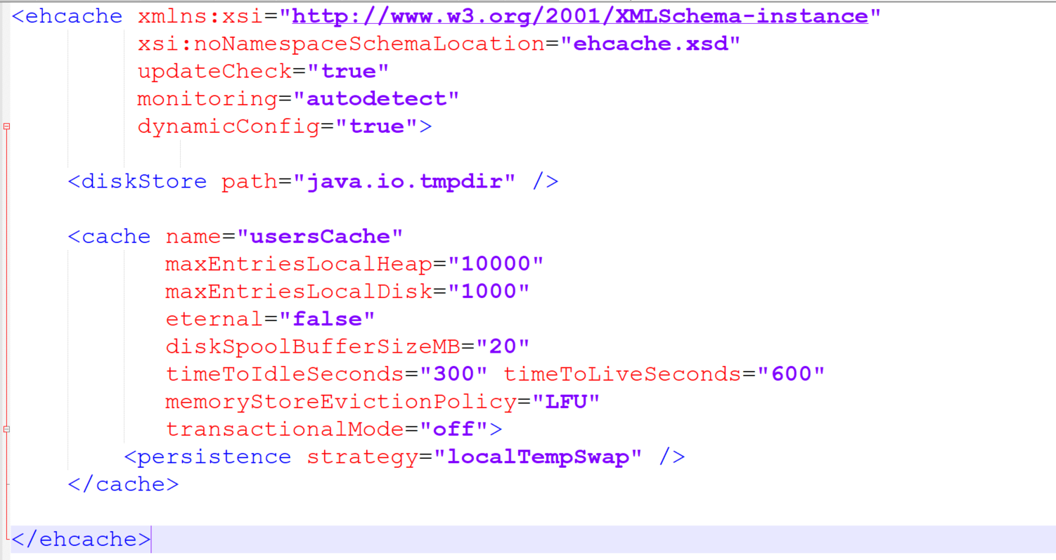
Spring Boot EH Cache

Slide 24
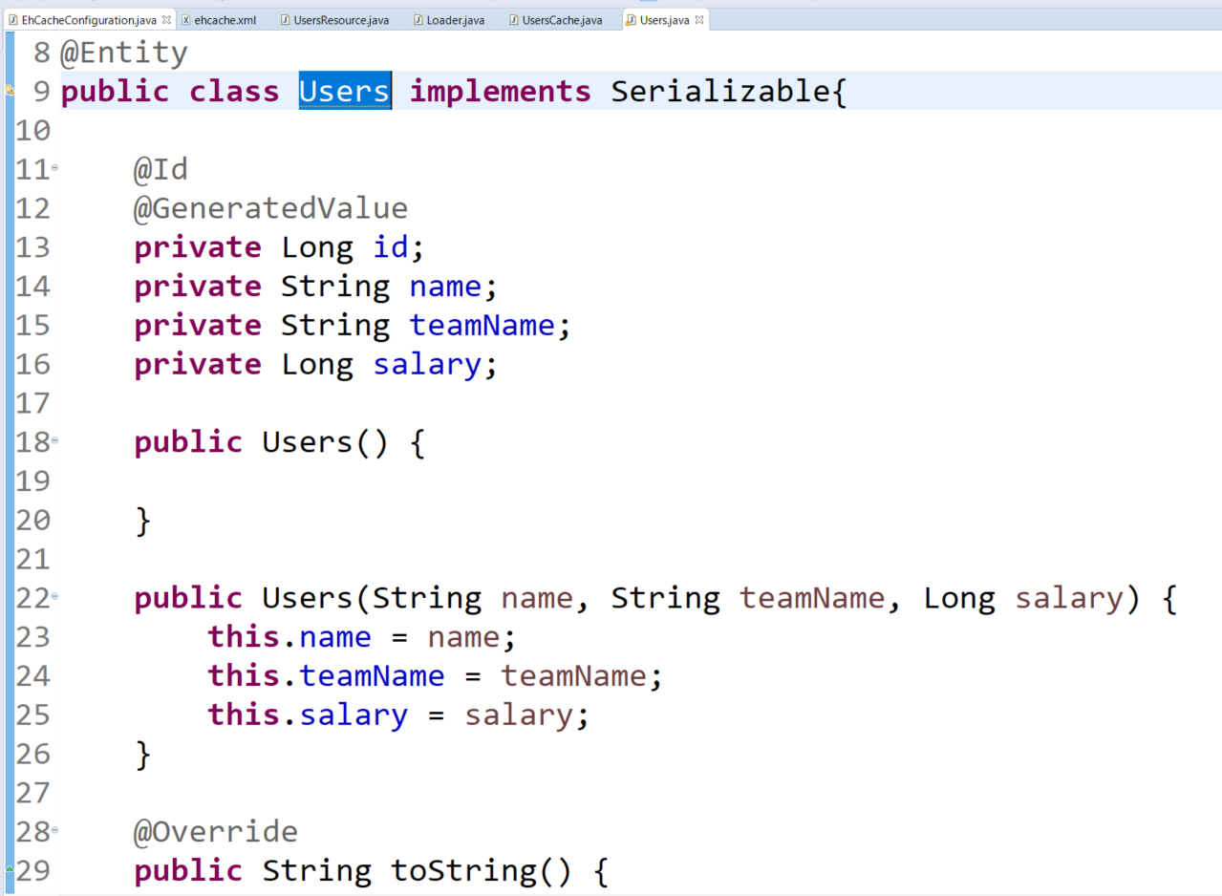
Spring Boot EH Cache

Slide 25
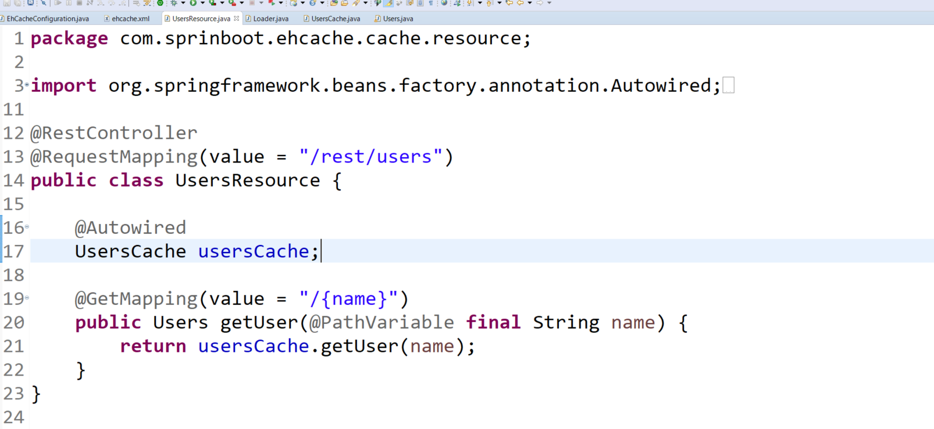
Spring Boot EH Cache

Slide 26
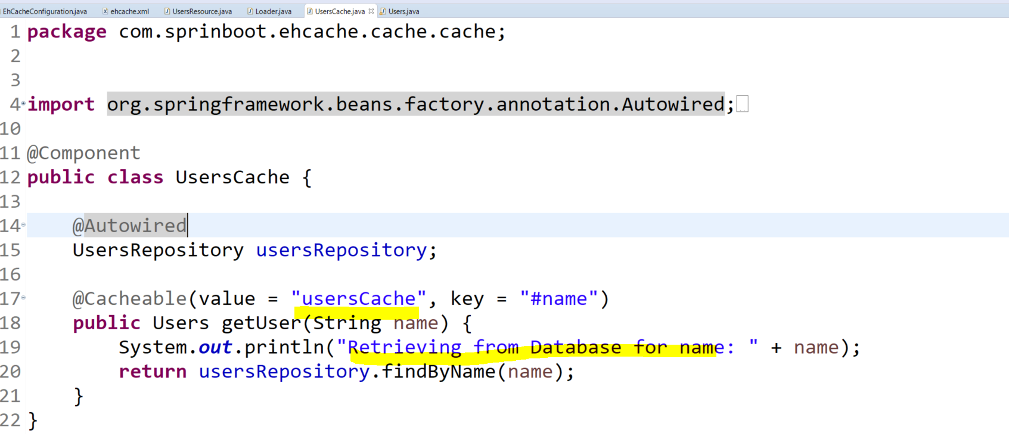
Spring Boot EH Cache

Slide 27
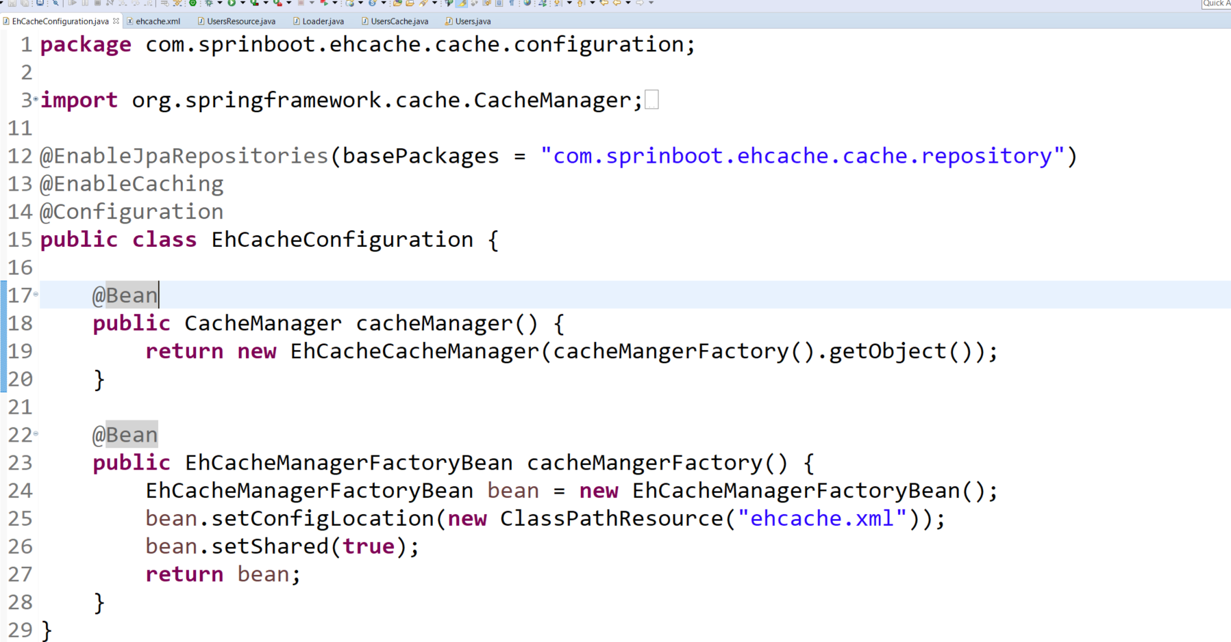
Spring Boot EH Cache

Slide 28
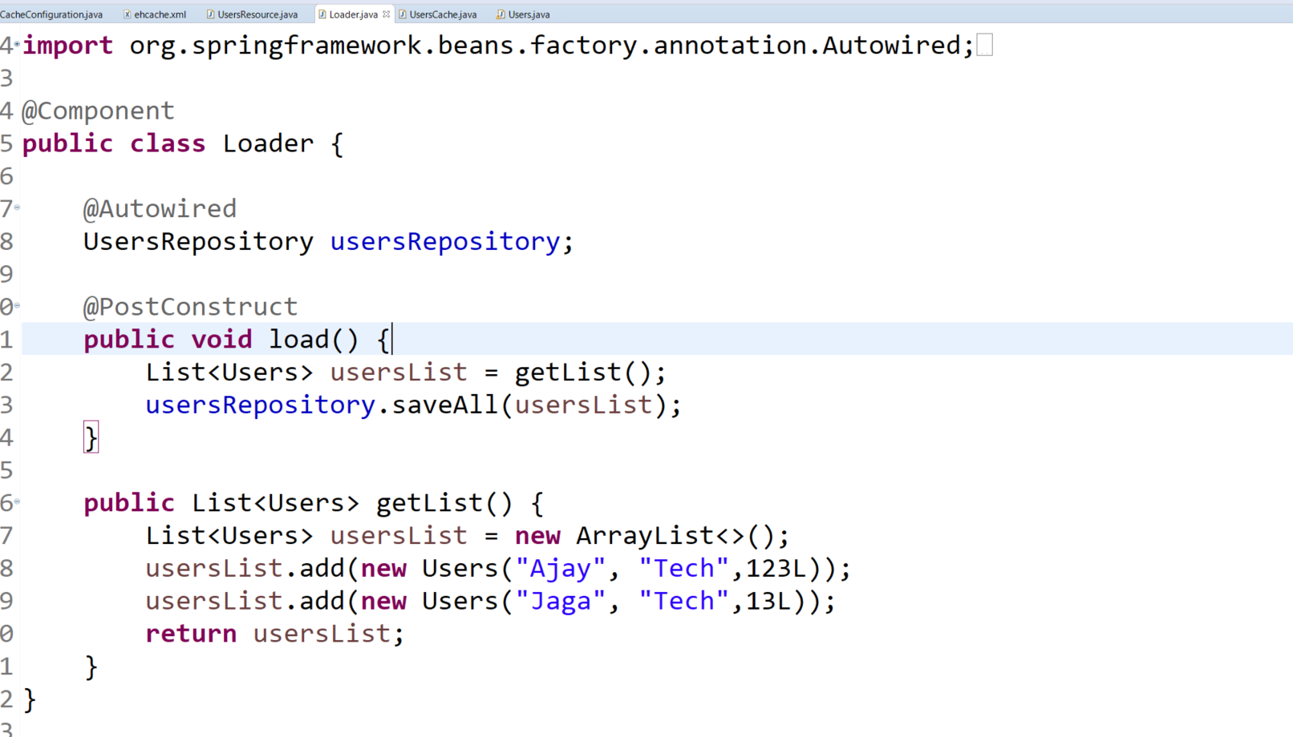
Spring Boot EH Cache

Slide 29
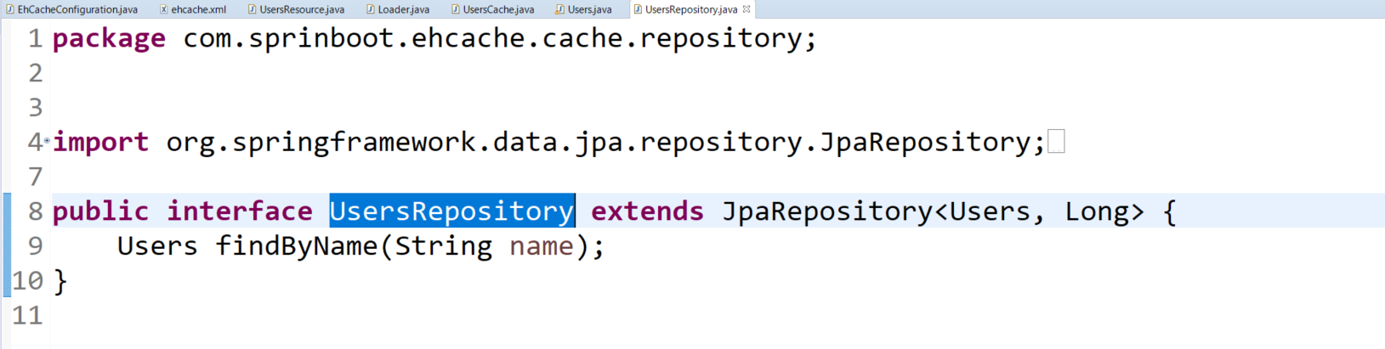
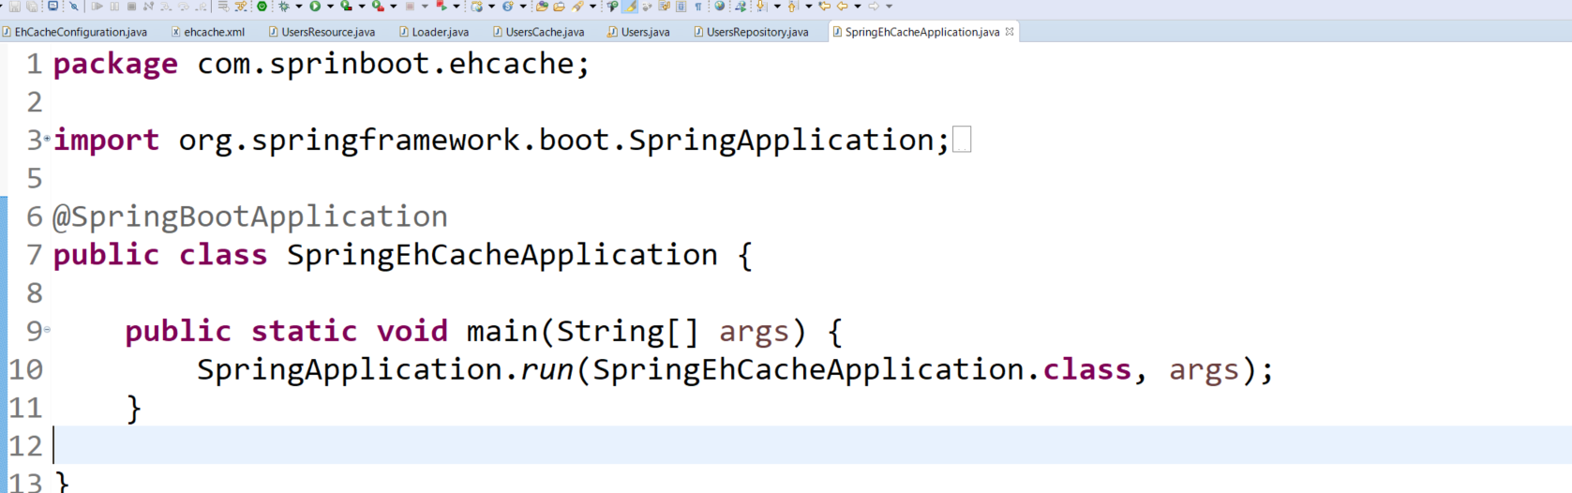
Spring Boot EH Cache

Slide 30
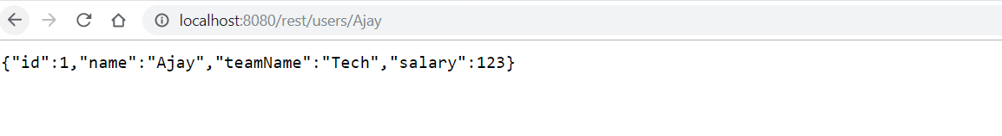
Spring Boot EH Cache

Slide 31
Spring Boot EH Cache

